Slide 1
Extensional tectonics in the Death Valley area, California: Transport of the Panamint Range structural block 80 km northwestward
Southern Walker Lane
Death Valley
Presented by Jenna Graham
Stewart, J.H., 1983. Extensional tectonics in the Death Valley area, California; transport of the Panamint Range structural block 80 km northwestward. Geology, v. 11, p. 153-157

Slide 2
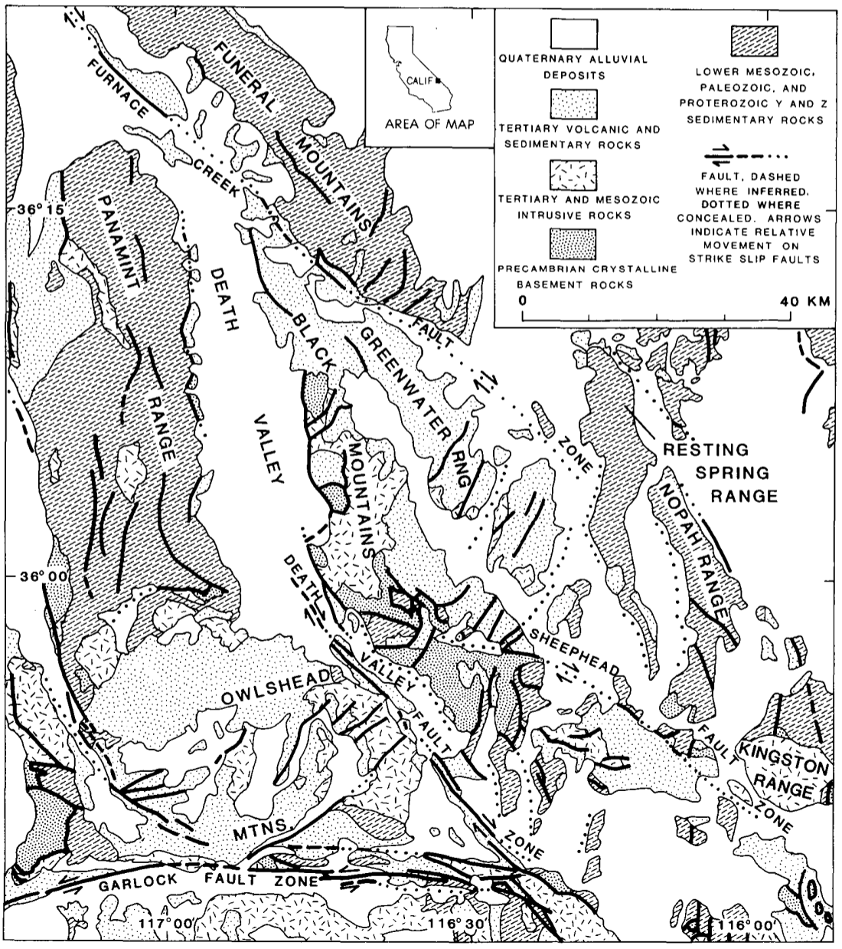
Introduction
Purpose:
To propose a new hypothesis to explain the strike-slip offsets and complex geologic features within the Death Valley area
Supporting Evidence – outlined
Tectonic Denudation of the Black Mountains
Abrupt end of the Furnace Creek Fault Zone
The Amargosa Fault and low-angle detachment faults
Turtleback surfaces
Stratigraphic reconstruction
1

Slide 3
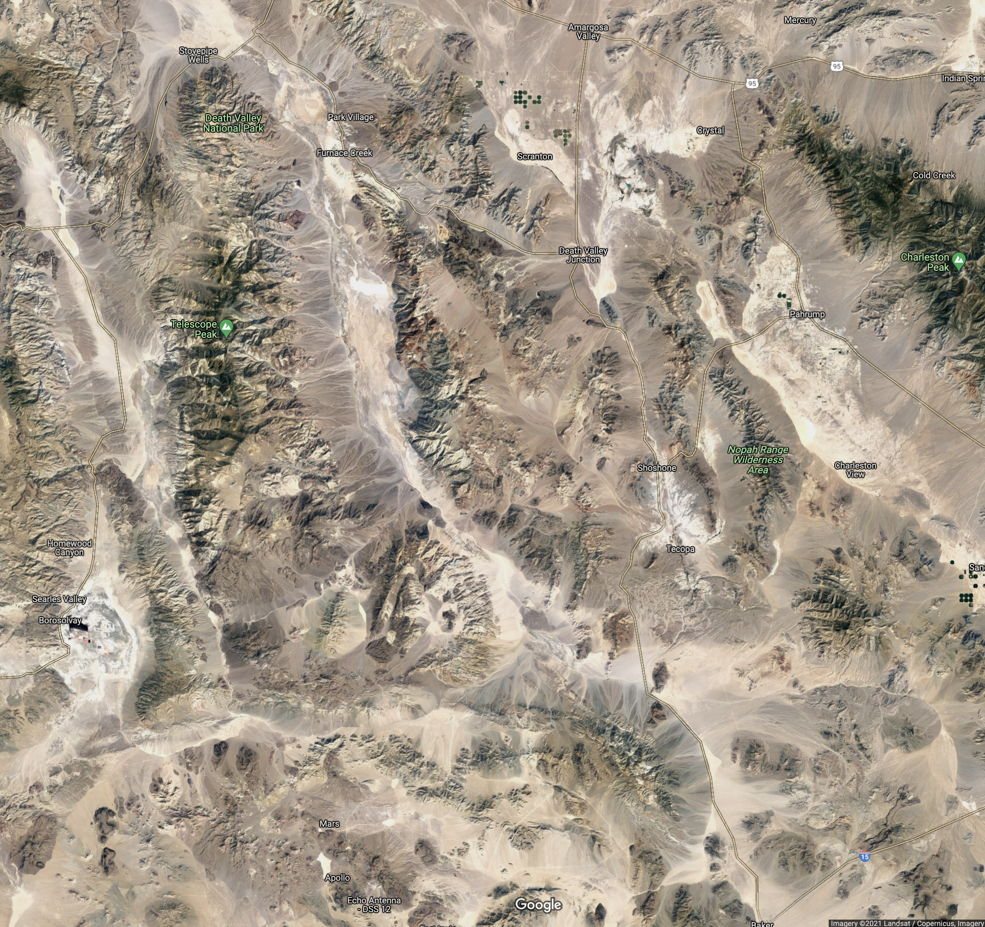
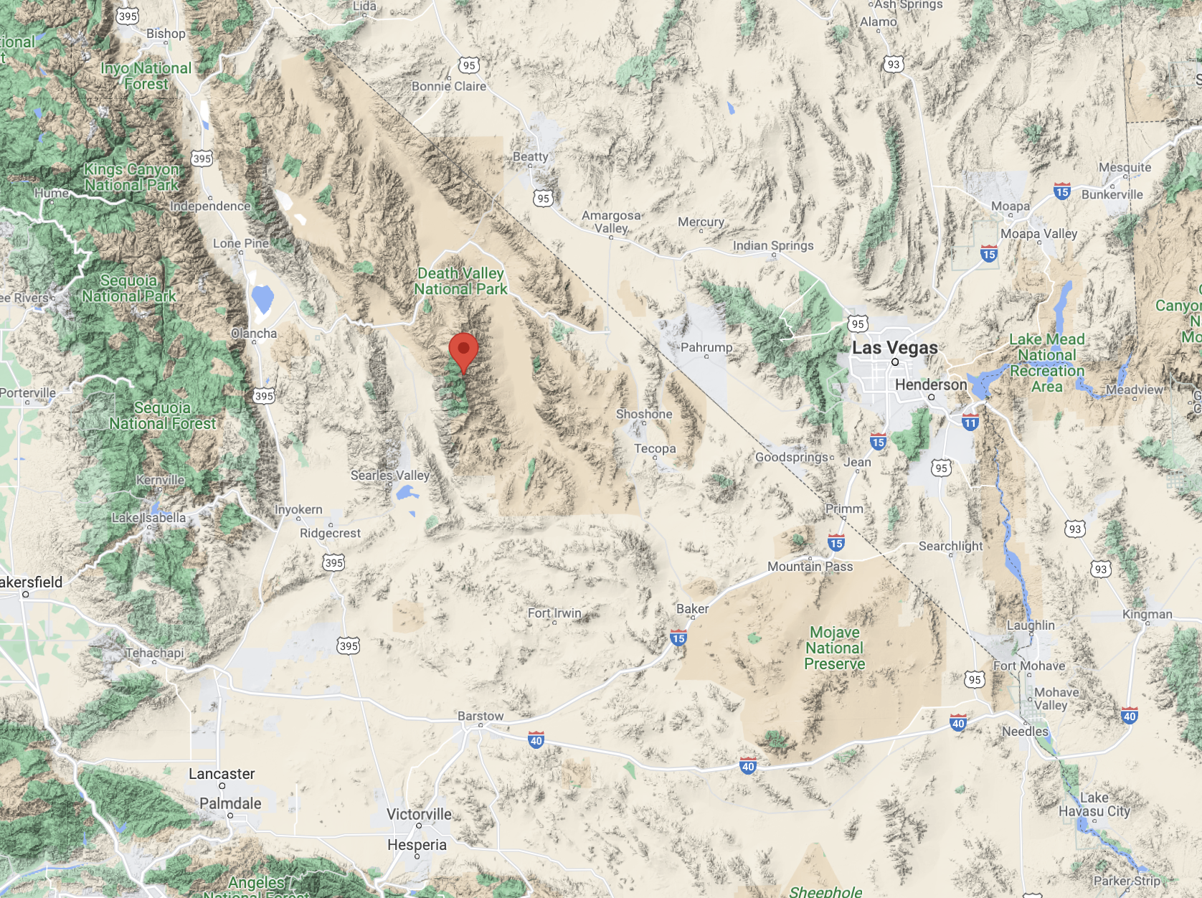
Setting the Scene is important.
Funeral Mountains
Furnace Creek Fault Zone
Greenwater Range
Panamint Range
Resting Spring Range
Death Valley
Black Mountains
Nopah Range
Death Valley Fault Zone
Garlock Fault Zone
2

Slide 4
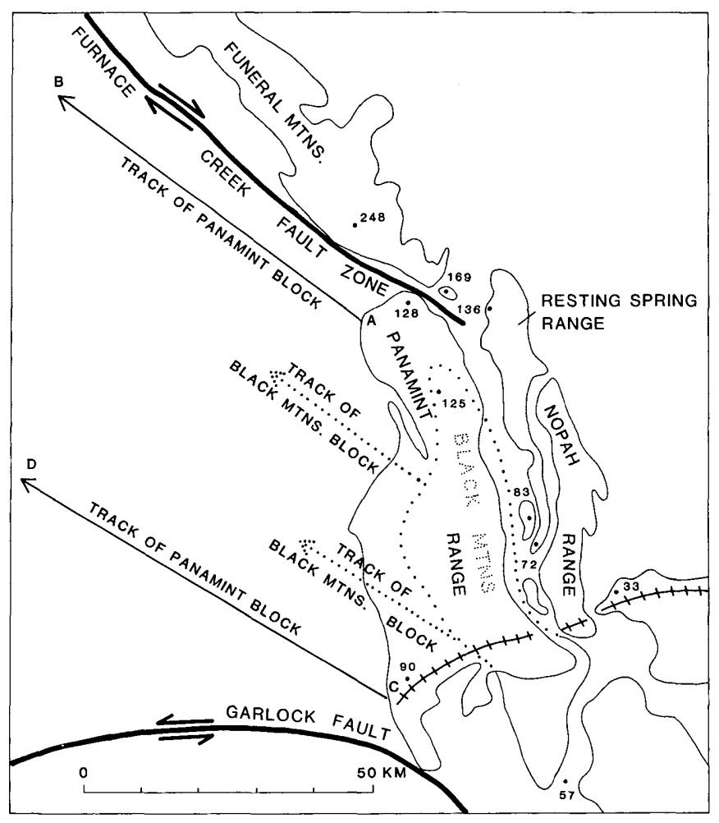
Hypothesis
The Panamint Range once laid adjacent to the Resting Spring and Nopah Ranges
The Panamint Range was then detached from the underlaying Precambrian rocks of the Black Mountains
Moved 80 km northwest via low-angle detachment fault(s)
Reconstruction of the area caused the Black Mountains to also move northwest
3

Slide 5
Supporting Evidence
Furnace Creek Fault Zone
Extends 200 km
Ends at the Resting Spring Range
Strike-slip offset accommodates the motion of the Panamint relative to the Funeral Mtn. Range
Tectonic Denudation
What is a tectonic denudation?
- the removal of crustal material as a result of erosion from tectonically produced uplift or low-angle normal faulting
Every mountain range within the area has a 10-km thick section of Precambrian and Paleozoic strata
Except the Black Mountains
Missing section indicates either erosion or tectonic denudation
Erosion is unlikely
Needed to be a large-scale event
No evidence of debris from erosion
Preservation in the other ranges
So,
Sedimentary sequence has been removed by tectonic denudation and left the Panamint Range
4

Slide 6
Supporting Evidence
Turtleback Faults
Copper Canyon, Death Valley
Turtleback fault
Eroded, dome-shaped features
3 within the Death Valley area
Large mullions representing part of the detachment fault
Striations, slickensides, northwest oriented extensional fractures
5

Slide 7
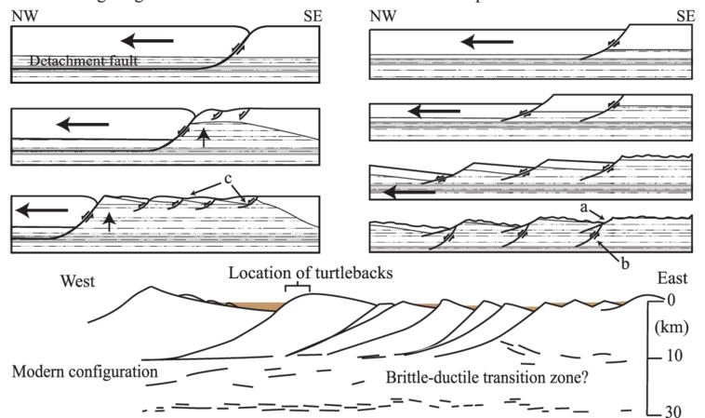
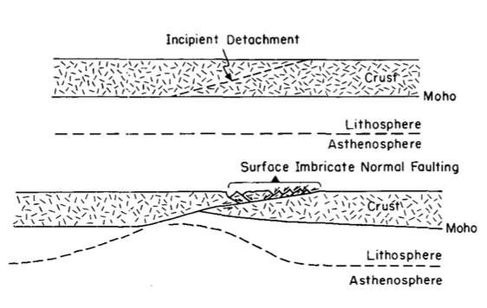
Supporting Evidence
Amargosa Fault
Known as the fault that transported the Panamint Range 80 km northwest
Middle to late Tertiary age
Extends from Panamint Range into the Death Valley area
Features lead to identification of normal faulting
Amargosa Chaos: “Complex mosaic of blocks and slices of upper Precambrian, Paleozoic, and Tertiary rocks lying on the fault surface”
Drag of rotated blocks, flattening of normal faults
30-50% extension of original width of Southern Death Valley area
Support the possibility of both a single fault and multiple fault system
Panamint contains unbroken sedimentary layers
This indicated the Amargosa fault dips under the Panamint Range
Rooted low-angle normal fault
6
Notes:
Sizemore, Travis & Wielicki, Matthew & Cemen, Ibrahim & Stockli, Daniel & Heizler, Matthew & Robinson, Delores. (2019). Structural evolution of central Death Valley, California, using new thermochronometry of the Badwater turtleback;. Lithosphere. 10.1130/L1044.1.

Slide 8
Stratigraphic reconstruction
Compares rock sections that are present in the ranges before detachment
Units found in the Panamint, Nopah, Resting spring Ranges and the Funeral Mountains
Furnace Creek Fault Zone has 40-100 km offset while Death Valley Fault Zone has < 8 km
Shown by Lower Cambrian Zabriskie Quartzite
Thinner sections towards the southeast
Connection to hypothesis:
No right-lateral offset is required in the southern Death Valley area as area experiences large extension
248
169
128
136
125
83
72
33
90
Offset can also be explained by regional affects
If the Panamint Range moved to the northwest, then the region to the west also had to move
FCFZ accommodated for area of extension
57
7

Slide 9
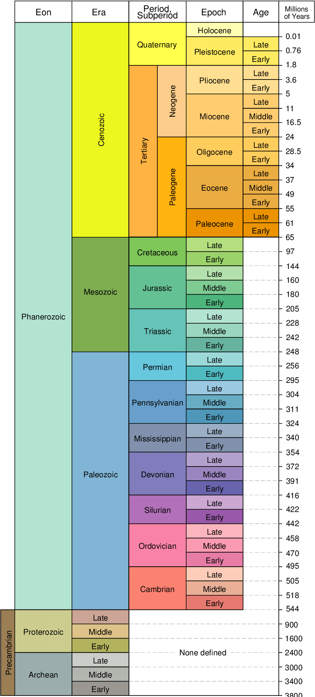
Timing and Regional Relations
Main time period: Mid – Late Cenozoic
Last movement of the detachment faults occurred in the late Cenozoic
Amargosa chaos – 6-8 m.y.-old Tertiary volcanic rocks
Tertiary Rocks of similar age also found in the Black Mountains
Artist Drive Formation: Death Valleys most violent volcanic period
Occurred during the Miocene
Denudation in the Black Mountains occurred before/slightly during the Artist Formation
Thin sections of strata, contacts are now faults
Turtleback faults formed during the late Cenozoic during deposition of the Black Mountains
8

Slide 10
Summary
Old hypotheses could not explain the differences of strike-slip offset on the Furnace Creek and Death Valley Fault Zones
New hypothesis suggests the Panamint Range was detached from the Black Mountains and transported 80 km to the northwest by low-angle detachment fault(s)
Evidence includes:
Tectonic Denudation
Geologic Structures – turtleback surfaces
Amargosa Fault
Abrupt end of the Furnace Creek Fault Zone
9

